Slide 1


Phishing awareness Training

Slide 2

Agenda
Introduction
Types of phishing attacks
Recognizing Phishing Emails
Avoiding Phishing Attacks
Interactive Quiz

Slide 3


Phishing is a type of cyber attack where attackers impersonate legitimate organizations to steal sensitive information. They often use emails, social media, or websites to trick individuals into providing personal data, such as passwords and credit card numbers. Understanding this tactic is the first step in prevention.
Introduction
What is Phishing?

Slide 4

Importance of Phishing Awareness
Phishing awareness is vital because it helps prevent data breaches, protects financial assets, and safeguards both personal and professional information. It reduces the impact of social engineering, enhances overall cybersecurity, and prevents malware and ransomware infections. Additionally, it fosters a security-conscious culture, reduces recovery costs, and educates users on best practices. Overall, awareness training empowers individuals and organizations to recognize and avoid phishing attacks, ensuring better protection against cyber threats.
Notes:
f

Slide 5

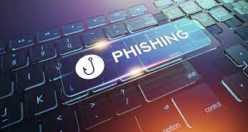
Types of Phishing Attacks

Slide 6
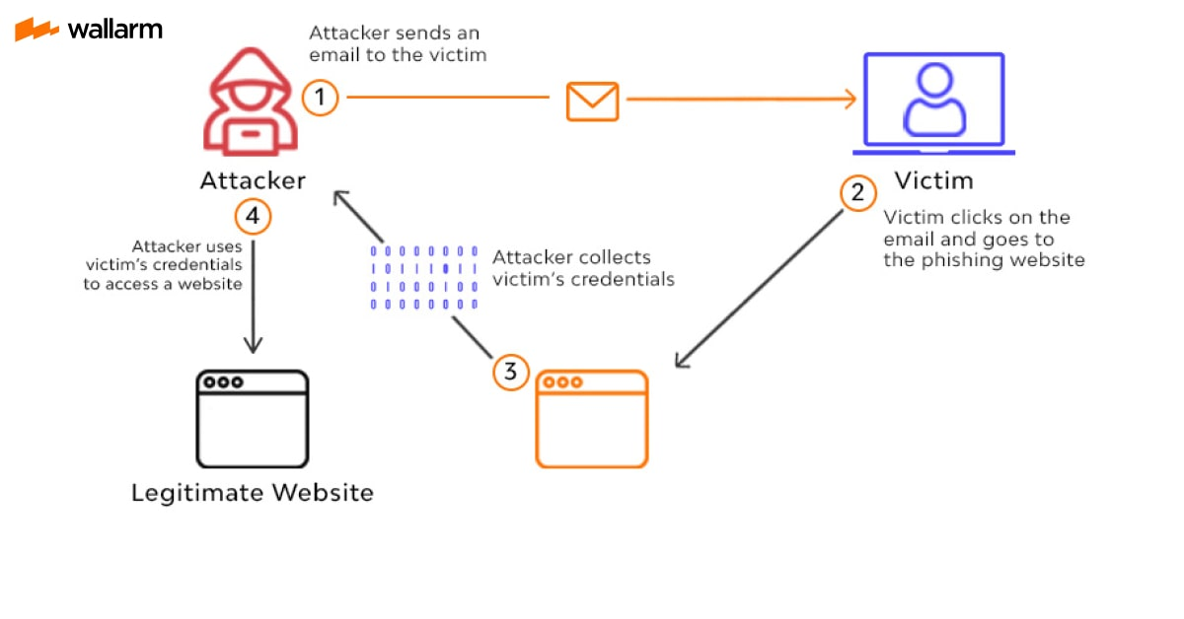
1. Email Phishing
The most common form, where attackers send fraudulent emails that appear to come from legitimate sources. These emails often contain malicious links or attachments designed to steal personal information.
Example: An email claiming to be from a bank asking you to verify your account information by clicking a link.
1.Create a Fake Email: Design a deceptive email that looks like it’s from a trusted source.
2.Trick the Victim: Include a malicious link or attachment to steal information or install malware when clicked.

Slide 7
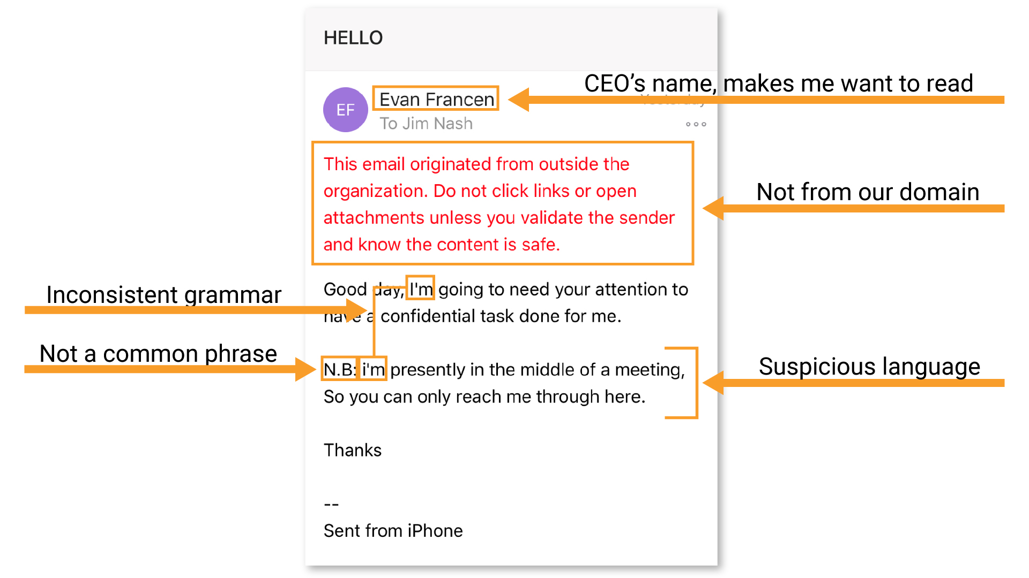
Targeted phishing attacks directed at specific individuals or organizations. Attackers gather information about the target to craft personalized messages that appear more credible. Example: An email that looks like it’s from your company’s IT department asking for your login credentials, tailored to your job role. 1.Research the Target: Gather detailed information about the individual or organization to create a personalized and convincing message. 2.Send a Targeted Email: Craft and send a customized email designed to trick the target into revealing sensitive information or performing a specific action.
2.Spear Phishing

Slide 8
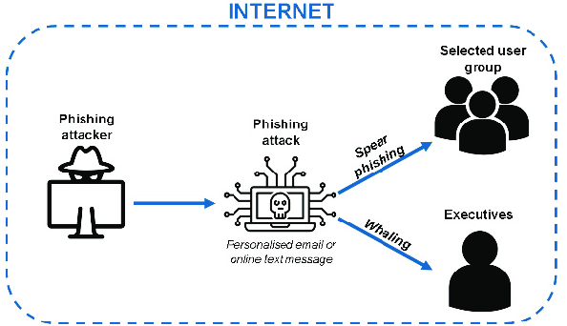
3. Whaling
A form of spear phishing aimed at high-profile individuals such as executives or senior officials within an organization. These attacks often involve highly customized and convincing messages.
Example: An email that appears to come from a trusted board member requesting sensitive financial information.
1.Identify the Target: Research high-profile individuals, such as executives or senior officials, to understand their roles, interests, and communication styles.
2.Craft a Convincing Email: Create a highly personalized and convincing email that appears to come from a trusted source, aiming to deceive the target into disclosing sensitive information or making significant decisions.

Slide 9
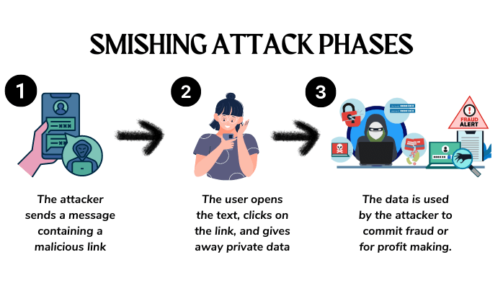
4. Smishing (SMS Phishing)
Phishing attacks conducted via text messages (SMS). These messages often contain links or requests for personal information.
Example: A text message claiming that your account is locked and prompting you to click a link to verify your identity.
1.Create a Deceptive SMS: Craft a text message that appears to come from a legitimate source, such as a bank or service provider, often with urgent or enticing language to prompt action.
2.Send the SMS and Trick the Victim: Send the message with a malicious link or request for personal information. When the recipient interacts with the link or responds, their information is captured or their device is compromised.

Slide 10
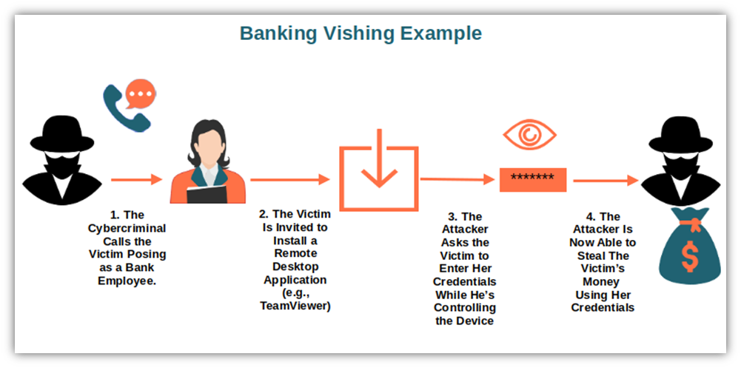
5. Vishing (Voice Phishing)
Phishing attacks carried out over the phone. Attackers impersonate legitimate entities to trick victims into revealing personal information or making fraudulent transactions.
Example: A phone call from someone pretending to be from your bank, asking you to provide your account details for verification.
Prepare a Persuasive Script: Develop a script that impersonates a trusted entity, such as a bank representative or customer service agent, and includes convincing details to gain the target’s trust.
Make the Phone Call and Extract Information: Call the target, using the script to persuade them to provide sensitive information or perform actions, such as verifying account details or making transactions.

Slide 11
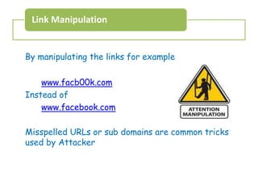
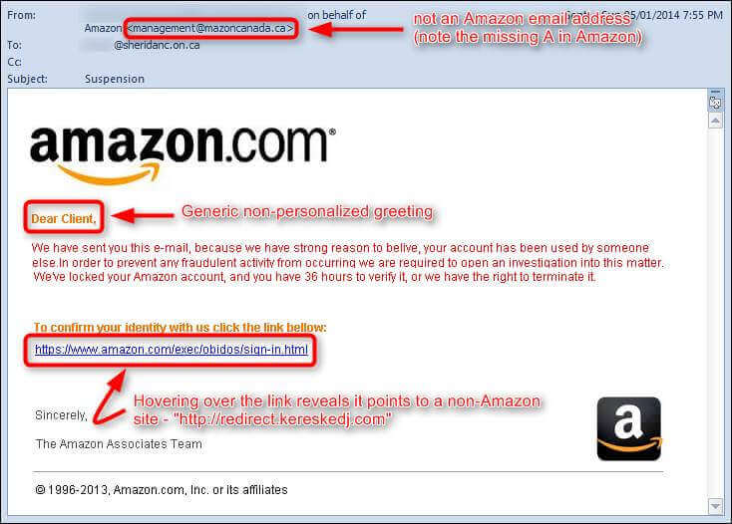
6.Link Manipulation Phishing
1.Create a Fake URL: Design a malicious URL that closely resembles a legitimate website’s URL. This might involve slight misspellings, subdomains, or domain name variations to trick the user into believing it’s the real site.
Embed the Fake URL: Insert the deceptive link into a phishing email, text message, or another communication. This link may direct the user to a counterfeit site designed to capture sensitive information or deliver malware.

Slide 12
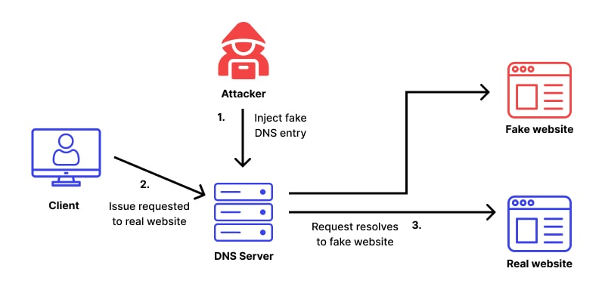
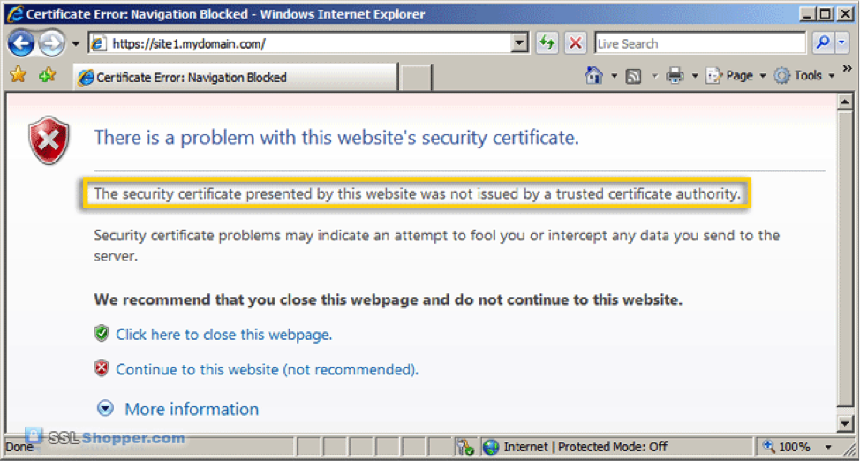
7.Pharming
Pharming
Attackers redirect users from legitimate websites to fraudulent ones, often through DNS manipulation or malware. The fake sites are designed to capture login credentials and other sensitive information.
Example: Visiting what looks like your bank’s website but is actually a fake site set up to steal your login credentials.

Slide 13

.Recognizing Phishing Emails
Common Signs of Phishing Emails
Unusual sender addresses
Generic greetings
Urgent or threatening language
Suspicious links or attachments

Slide 14
Tips to protect yourself from phishing attacks
Be Skeptical of Unexpected Communications: Avoid clicking on links or downloading attachments from unknown or unexpected emails, messages, or phone calls.
Verify the Sender: Check the sender’s email address or phone number carefully. Legitimate organizations usually use official domains and contact information.
Hover Over Links: Hover your mouse over links to preview the URL before clicking. Ensure it matches the expected destination and is not a misspelled or unfamiliar domain.
Use Two-Factor Authentication (2FA): Enable 2FA on your accounts to add an extra layer of security. Even if credentials are compromised, 2FA can prevent unauthorized access.
Keep Software Updated: Regularly update your operating system, browsers, and security software to protect against vulnerabilities and threats.
6. Educate Yourself and Others: Stay informed about common phishing tactics and educate others. Regular training can help recognize and avoid phishing attempts.
7. Use Security Software: Install and maintain reputable antivirus and anti-malware software to detect and block phishing threats.

Slide 15
Check for Secure Websites: Ensure websites are secure by looking for “https” in the URL and a padlock icon in the browser’s address bar before entering sensitive information.
Be Cautious with Personal Information: Avoid sharing personal information or login credentials over email or phone unless you are certain of the recipient’s legitimacy.
Report Suspicious Activity: Report suspected phishing attempts to your IT department, email provider, or relevant authorities to help prevent further attacks.
Educate Yourself and Others: Stay informed about common phishing tactics and educate others. Regular training can help recognize and avoid phishing attempts.
Use Security Software: Install and maintain reputable antivirus and anti-malware software to detect and block phishing threats.
Check for Secure Websites: Ensure websites are secure by looking for “https” in the URL and a padlock icon in the browser’s address bar before entering sensitive information.
Be Cautious with Personal Information: Avoid sharing personal information or login credentials over email or phone unless you are certain of the recipient’s legitimacy.
Report Suspicious Activity: Report suspected phishing attempts to your IT department, email provider, or relevant authorities to help prevent further attacks.

Slide 16

what to do if u receive a phishing phone call
If you receive a phishing phone call:
Hang Up : immediately to end the call.
Do Not Share Personal Information during the call.
Verify the Caller’s Identity: by contacting the organization directly using a known phone number.
Report the Incident :to your IT department or relevant authorities.
Block the Number: to prevent future calls.
Monitor Your Accounts: for unusual activity and report it if necessary.
Educate Yourself and Others: about phishing tactics to prevent further incidents.

Slide 17

Conclusion
By understanding phishing and its tactics, you can better protect yourself and your organization. Stay vigilant, report suspicious activities, and continuously educate yourself on cybersecurity. Together, we can create a safer digital environment.
Phishing attacks pose a serious threat by tricking individuals into revealing sensitive information. To protect yourself, recognize common phishing tactics, use preventive measures like two-factor authentication, and respond appropriately by reporting suspicious activity. Staying informed and vigilant helps safeguard against these attacks and enhances overall security.

Slide 18
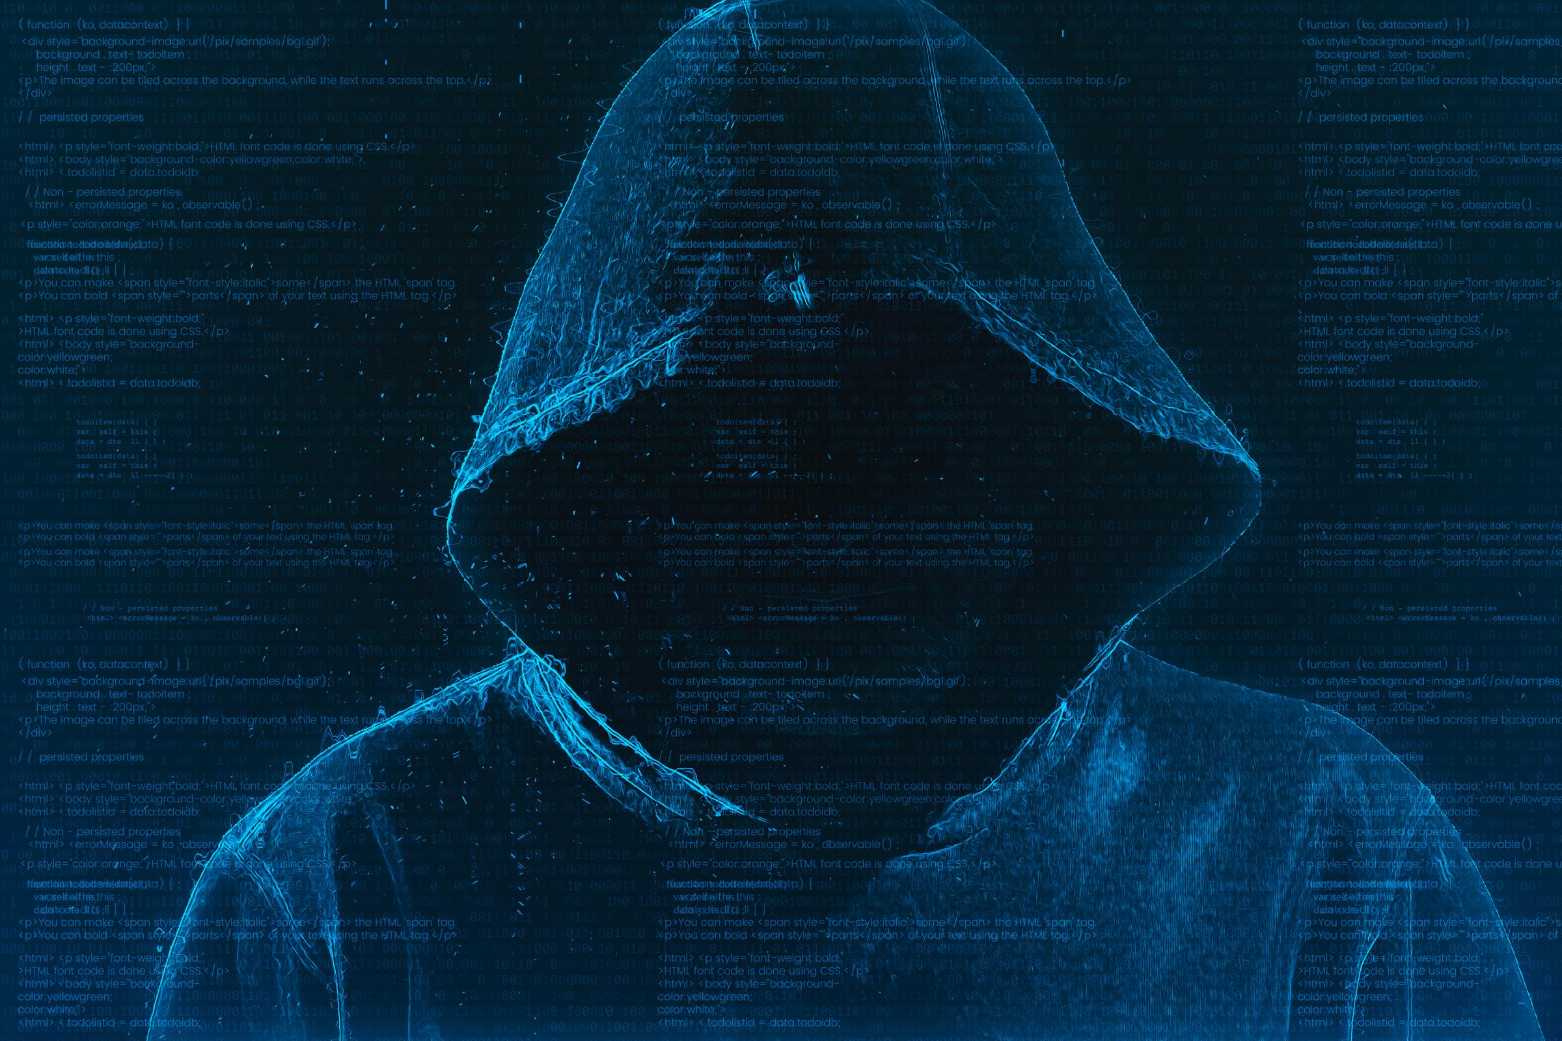
Thank You
ARATHI SHREE V
arathireddy2626@gmail.com

